Slide 1

Automotive Technology: A Systems Approach, 8e
Chapter 15: Basics of Electrical Systems
Rob Thompson and Jack Erjavec, Automotive Technology: A Systems Approach, 8th Edition. © 2025 Cengage. All Rights Reserved. May not be scanned, copied or duplicated, or posted to a publicly accessible website, in whole or in part.

Slide 2
Chapter Objectives
15.01 Explain the basic principles of electricity.
15.02 Define the terms normally used to describe electricity.
15.03 Use Ohm’s law to determine voltage, current, and resistance.
15.04 List the basic types of electrical circuits.
15.05 Describe the differences between a series circuit and a parallel circuit.
15.06 Identify the various electrical components and their uses in electrical circuits.

Slide 3
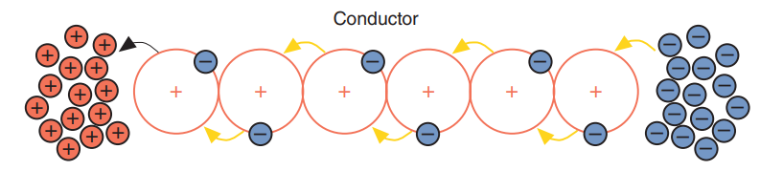
Basics of Electricity (1 of 2)
15.01 Explain the basic principles of electricity.
Electricity is the result of the flow of electrons from one atom to another.
The release of energy as one electron leaves the orbit of one atom and jumps into the orbit of another is electrical energy.
The key to creating electricity is to provide a reason for the electrons to move to another atom.
An electrical power source provides for a more positive charge, and to allow for a continuous flow of electricity, it supplies free electrons.

Slide 4
Basics of Electricity (2 of 2)
To have a continuous flow of electricity, three things must be present:
  An excess of electrons in one place,
  A lack of electrons in another place,
  A path between the two places.
A car’s battery is a source of chemical energy. The chemical reaction in a battery provides for an excess of electrons in one place and a lack of electrons in another.
Batteries have two terminals, a positive and a negative. Basically, the negative terminal is the outlet for the electrons, and the positive is the inlet for the electrons. The chemical reaction in a battery causes a lack of electrons at the positive (+) terminal and an excess at the negative (–) terminal.
The vehicle’s charging system restores the battery’s supply of electrons. This allows the chemical reaction to continue indefinitely. Electricity and magnetism are interrelated. One can be used to produce the other.
This process of producing electricity through magnetism is called induction. The heart of a vehicle’s charging system is the AC generator

Slide 5
Electrical Terms (1 of 3)
15.02 Define the terms normally used to describe electricity.
Electrical current describes the movement or flow of electricity. The greater the number of electrons flowing past a given point in a given amount of time, the more current the circuit has.
The unit for measuring electrical current is the ampere, usually called an amp. The term ampere is used to honor André Ampère, who studied the relationship between electricity and magnetism.
The instrument used to measure current in a circuit is called an ammeter. When electricity flows, millions of electrons are moving past any given point at the speed of light.
There are two types of current:
  Direct current (DC)
  Alternating current (AC)

Slide 6
Electrical Terms (2 of 3)
In direct current (DC), the electrons flow in one direction only.
In AC, the electrons change direction at a fixed rate.
Most automotive systems rely on DC current, and the current used in homes and buildings is AC.
However, some automotive parts generate or use AC.
Voltage may also be called electromotive force (EMF) and is measured in units called volts.
These units of measure for electrical pressure are named to honor Alessandro Volta, who, in 1800, made the first electrical battery. When any substance flows, it meets resistance.
The resistance to electrical flow can be measured.
The resistance to current flow produces heat. This heat can be measured to determine the amount of resistance.

Slide 7

Electrical Terms (3 of 3)
A unit of measured resistance is called an ohm, and the common symbol for an ohm is shown.
Resistance can be measured by an instrument called an ohmmeter.
To visualize electricity as something we are familiar with, many people use water as an analogy:
  Water pressure, supplied by the city water system or by a pump, is similar in concept to voltage.
  Electron flow or amperage is similar to the amount of water that flows from a hose or faucet.
  The size of a water hose or faucet opening is similar to electrical resistance.
  Turning a faucet on slightly allows only a little bit of water to flow through, which has the effect of resistance to flow.
  Opening the faucet further is like reducing the resistance in a circuit and allowing more current to flow.

Slide 8
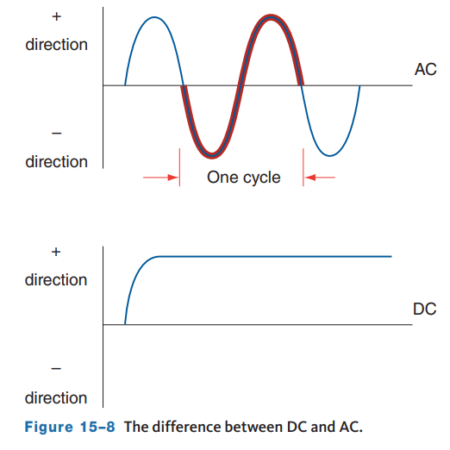
Alternating Current (AC)
The value of the voltage in an AC circuit constantly changes, as does the direction of the current.
If a graph is used to represent the amount of DC voltage available from a battery during a fixed period, the line on the graph will be flat, which represents a constant voltage.
If AC voltage is shown on a graph, it will appear as a sine wave. The sine wave shows AC changing in amplitude (strength) and direction.
The movement of the AC from its peak at the positive side of the graph to the negative side and then back to the positive peak is commonly referred to as “peak-to-peak” value.
The difference between the peak positive value and the peak negative value is used to measure AC voltages.

Slide 9
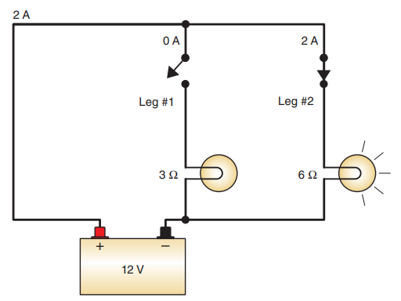
Circuit Terminology
A completed circuit is called a closed circuit, whereas an incomplete circuit is called an open circuit.
When a circuit is complete, there is continuity. This means that there is a continuous or complete path between two points for current to flow through.
Conductors are drawn in electrical diagrams as a line connecting two points, as shown.
In a complete circuit, the flow of electricity can be controlled and applied to do work, such as light a headlamp or run a motor.
Components that use electrical power control the current in the circuit and convert electrical energy into another form of energy. These components are referred to as electrical loads.
Loads are drawn in electrical diagrams as a symbol.

Slide 10
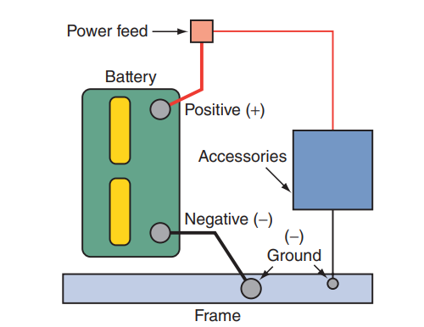
Grounding the Load
Most automotive electrical circuits use the chassis as a conductor for the negative side of the battery, as shown.
Current passes from the battery, through the load, through the metal frame, and back to the battery.
Using the frame as a return path or ground eliminates the need for a separate ground wire at each component.
Without grounding parts to the frame, hundreds of additional wires would be needed to complete the individual circuits.
Other parts have a separate ground wire that connects them to the frame, engine, or transmission which are called chassis ground connections.
The wire that serves as the contact to the chassis is commonly called the ground wire or lead.

Slide 11
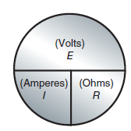
Ohm’s Law (1 of 2)
15.03 Use Ohm’s law to determine voltage, current, and resistance.
In 1827, a German mathematics professor, Georg Ohm, published a book that included his explanation of the behavior of electricity.
He found it takes 1 volt of electrical pressure to push 1 ampere of electrical current through 1 ohm of resistance.
This statement is the basic law of electricity and is known as Ohm’s law.
In any electrical circuit, current (I), resistance (R), and voltage (E) are mathematically related, and this relationship is expressed in a mathematical statement of Ohm’s law.
Ohm’s law can be applied to the entire circuit or to any part of a circuit.
When any two factors are known, the third factor can be found.

Slide 12
Ohm’s Law (2 of 2)
In DC circuits, if voltage remains constant, resistance and amperage will have an inverse effect on each other.
As resistance increases, amperage will decrease.
Conversely, if resistance decreases, amperage will increase. In addition, when working with resistances in a series circuit, Ohm’s law allows for adding the resistances together to determine total circuit resistance.
Resistances can be added together because they are like terms. This means that voltages also can be added together, just as amperages can be added together. Because volts and amps are not like terms, they cannot be added together.
Understanding these aspects of Ohm’s law will help you understand how to apply it, not just to electrical circuits on paper, but also in practice on a vehicle.
It also explains how an increase or decrease in voltage, resistance, or current affects a circuit.

Slide 13
Kirchhoff’s Law
In the 1840s, German physicist Gustav Kirchhoff described two laws on the behavior of electricity.
Both laws relate to Ohm’s law and help define the characteristics of series and parallel circuits.
Kirchhoff’s “voltage law” (KVL) basically states that the sum of the voltage drops in a closed circuit equals the voltage applied to that circuit.
Kirchhoff’s “current law” (KCL) explains the behavior of current in a parallel circuit.
  This law can be safely stated as: “At any junction point in a circuit, the current arriving to that point is equal to the current leaving.”

Slide 14
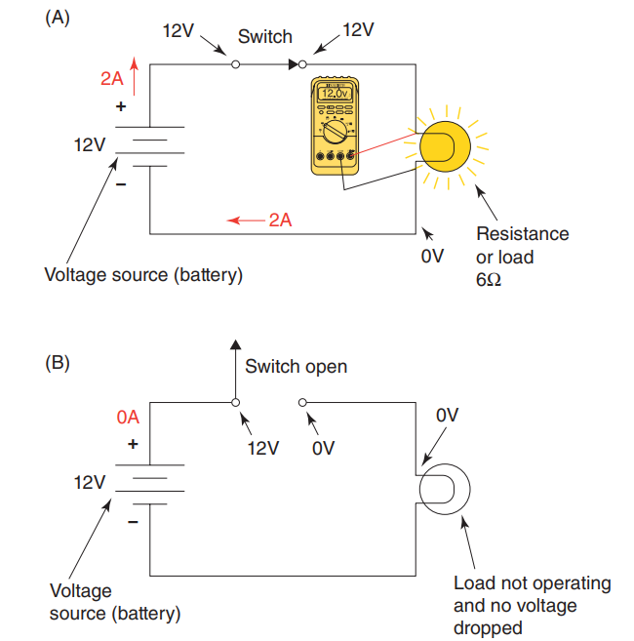
Voltage Drops
Voltage drop is the amount of voltage required to cause current flow through a load.
For there to be voltage dropped, the circuit must be complete.
An open circuit does not have any voltage drop since there is no current flow.
The voltage is dropped as a result of the change in electrical energy (voltage) into another form of energy, such as the heat generated from a light bulb.
As electrical energy is changed to another form of energy as it flows through a load, the amount of voltage leaving the load is lower than it was when it entered.
If there is only one load in the circuit, the voltage drop will equal the source voltage.
Unwanted resistance will become unwanted voltage drop.

Slide 15
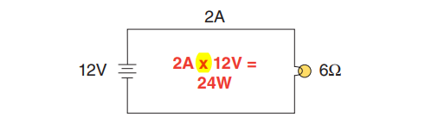
Power and Watt’s Law
Watt’s law defines the relationship between power, amperage, and voltage. The power in a DC electrical circuit is the product of the amperage and voltage.
The formula used to calculate the electrical power (P) used by a load is mathematically expressed by P = I × E.
In other words, power equals current multiplied by voltage.
Electric power is expressed in watts and represents the rate at which electrical energy is converted to another form of energy.
Electrical energy can be converted into sound, heat, light, or motion.

Slide 16
Discussion
Considering Ohms law, Kirchhoff’s law, and what you have learned about voltage drops, have a class discussion about these relationships.
If unwanted resistance occurs in a circuit, how does it affect current, voltage drop, the overall circuit performance? What could the unwanted resistance be? What might it look like?

Slide 17
Circuits
15.04 List the basic types of electrical circuits.
Most automotive circuits contain five basic parts.
Power sources, such as a battery or generator, that provide the energy needed to cause electron flow
Conductors, such as copper wires, that provide a path for current flow
Loads, which are devices that use electricity to perform work, such as light bulbs, electric motors, or resistors
Controllers, such as switches or relays, that control or direct the flow of electrons
Circuit protection devices, such as fuses, circuit breakers, and fusible links
Three basic types of circuits are used in automotive electrical systems:
series circuits
  parallel circuits
  series-parallel circuits
Each type has its own characteristics regarding amperage, voltage, and resistance.

Slide 18
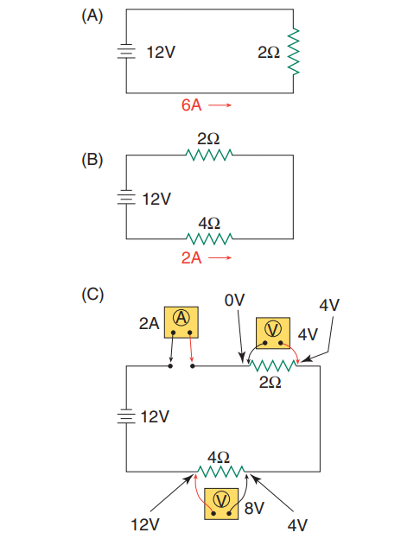
Series Circuits (1 of 2)
15.05 Describe the differences between a series circuit and a parallel circuit.
A series circuit consists of one or more loads connected to a voltage source with only one path for electron flow.
  For example, a simple series circuit consists of a resistor (2 ohms in this example) connected to a 12-volt battery.
  The current can be determined by applying Ohm’s law.
Another series circuit may contain a 2-ohm resistor and a 4-ohm resistor connected to a 12-volt battery.
The word series is given to a circuit in which there is only one current path, and the same amount of current is present throughout the circuit.
This means that the current that flows through one point in the circuit is the same amount of current that flows through all parts of the circuit.

Slide 19
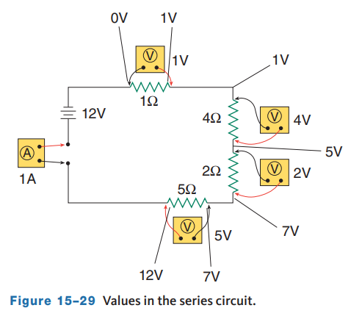
Series Circuits (2 of 2)
An ammeter connected anywhere in this circuit will read 2 amperes, and a voltmeter connected across each of the resistors will read 4 volts and 8 volts, as shown.
The power used by the circuit is 24 watts (12 volts × 2 amps = 24 watts).
All calculations for a series circuit work in the same way no matter how many resistances there are in series.
Using Ohm’s law, we can see that the circuit current is 1 amp (I = E/R = 12∕12 = 1 amp).
We can also add each of the resistors to determine a total circuit resistance of 12 ohms.
We can also use Ohm’s law to determine the voltage drop across each resistor in the circuit.

Slide 20
Parallel Circuits (1 of 5)
A parallel circuit provides two or more different paths for current flow.
Each path has separate loads and can operate independently of the other paths.
The different paths for current are commonly called the legs or branches of a parallel circuit.
A parallel circuit is characterized by the following:
  Total circuit resistance is always lower than the resistance of the leg with the lowest total resistance.
  The current through each leg will be different if the resistance values are different.
  The sum of the current on each leg equals the total circuit current.
  The voltage applied to each leg of the circuit will be dropped across the legs if there are no loads in series with the parallel circuit.

Slide 21
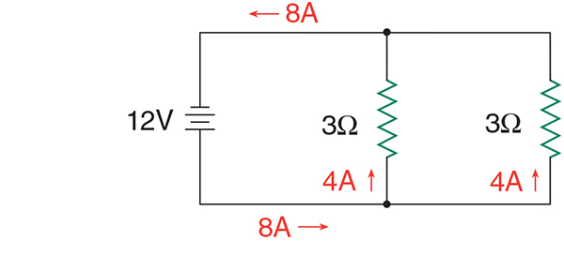
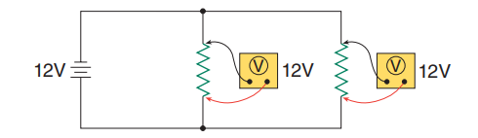
Parallel Circuits (2 of 5)
As shown, two 3-ohm resistors are connected to a 12-volt battery.
The resistors are in parallel with each other, since the battery voltage (12 volts) is applied to each resistor and they have a common negative lead.
The current through each resistor or leg can be determined by applying Ohm’s law.
For the 3-ohm resistors, I = E/R = 12∕3 = 4 amperes.
Therefore, the total circuit current supplied by the battery is 4 + 4 = 8 amperes.
Using Ohm’s law, we find that 12 volts are dropped by both resistors.

Slide 22


Parallel Circuits (3 of 5)
When adding loads to a parallel circuit, power consumption is increased.
In the previous example, the power used by the circuit increased to 96 watts.
Had the 3-ohm resistors been in series, total power would have been only 24 watts.
Resistances are not added up to calculate the total resistance in a parallel circuit; rather, total resistance is determined by dividing the product of their ohm values by the sum of their ohm values as shown below.
For this circuit, the resistance total is 1.5 ohms and the formula is written below.

Slide 23


Parallel Circuits (4 of 5)
Current flow through the circuit can be calculated by different methods. Using Ohm’s law, we know that I = E/R. If we take the total resistance of each leg and divide it into the voltage, we then know the current through that leg. Since total circuit current is equal to the sum of the current flows through each leg, we simply add the current across each leg together. This will give us total circuit current.
2 amps + 4 amps = 6 amps which is the total circuit current. Circuit current can also be determined by finding the total resistance of the circuit. To do this, the product-over-sum formula is used. By dividing this total into the voltage, total circuit current is known.

Slide 24

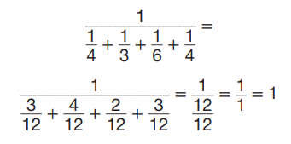
Parallel Circuits (5 of 5)
Since I = E/R, I = 12∕2, I = 6 amps (total circuit current). When a circuit has more than two legs, the reciprocal formula should be used to determine total circuit resistance. The formula follows:
Here is a parallel circuit with four legs. The resistances across each leg are 4 ohms, 3 ohms, 6 ohms, and 4 ohms. Using the reciprocal formula, we will find that the total resistance of the circuit is 1 ohm:
(Note that the total resistance is lower than the leg with the lowest resistance.)

Slide 25
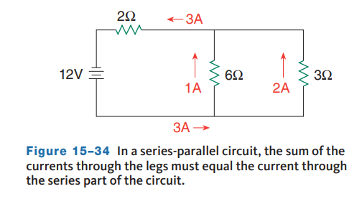
Series-Parallel Circuits (1 of 2)
In a series-parallel circuit, both series and parallel combinations exist in the same circuit.
If you are faced with the task of calculating the values in a series-parallel circuit, determine all values of the parallel circuit(s) first.
By looking carefully at a series-parallel circuit, you will find that it is nothing more than one or more parallel circuits in series with each other or in series with some other resistance.
A series-parallel circuit is shown. The 6- and 3-ohm resistors are in parallel with each other and together are in series with the 2-ohm resistor.

Slide 26
Series-Parallel Circuits (2 of 2)
The total resistance can be determined as follows:
  The 6- and 3-ohm parallel resistors are equivalent to a 2-ohm resistor since (6 × 3)/(6 + 3) = 2.
  This equivalent 2-ohm resistor is in series with the other 2-ohm resistor.
  To find the total resistance, add the two resistance values together.
  This gives a total circuit resistance of 4 ohms (2 + 2 = 4 ohms).
  The total current, therefore, is I = 12/4 = 3 amperes.
  3 amps are divided between the resistors in parallel proportional to their resistance so 1 amp through the 6 ohm leg and 2 amps through the 3 ohm leg.

Slide 27
Circuit Components (1 of 5)
15.06 Identify the various electrical components and their uses in electrical circuits.
Most of today’s vehicles operate with basically 12-volt electrical systems.
The word basically is used because the battery is rated at 12 volts but stores 12.6 volts, and the charging system puts out about 14 volts while the engine is running.
Because the charging system is the primary source of electrical power, it is fair to say that an automobile’s electrical system is a 14-volt system.
In 1954, General Motors equipped its Cadillac with a 12-volt system. Prior to 1954, vehicles had 6-volt systems.
The electrical demands of accessories, such as power windows and seats, put a severe strain on the 6-volt battery and charging system.
With a 12-volt system, the charging system had to work less hard, and there was plenty of electrical power for the electric accessories.
The increase in voltage also allowed wire sizes to decrease because the amperage required to power things was reduced.

Slide 28
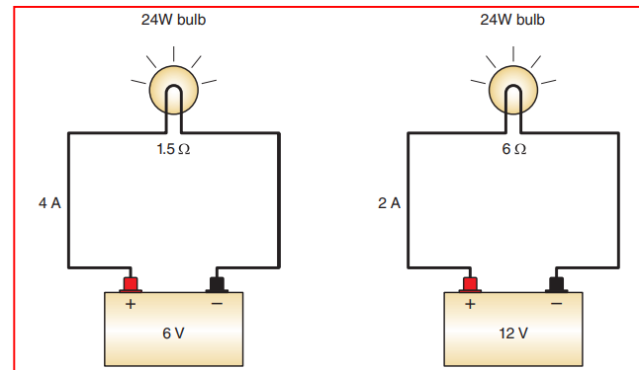
Circuit Components (2 of 5)
To explain this, consider an accessory that required 20 amps to operate in a 6-volt system (120 watts).
When the voltage was increased to 12 volts, the system only drew 10 amperes. Increasing system voltage allows wire gauge to decrease as the current-carrying capacity of the wire is reduced.
One should expect to see manufacturers move to 48-volt systems to keep pace with increased electrical demand while reducing the size of the wiring needed to supply to many accessories.
To meet these demands, there are two possible solutions: increase the amperage capacity of the battery and charging system or increase system voltage.
Higher-amperage batteries and generators are only a Band-Aid solution.

Slide 29
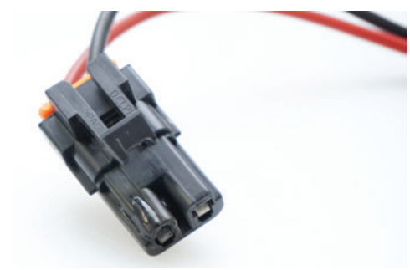
Circuit Components (3 of 5)
Loads
  Electrical loads can be thought of as energy conversion devices.
  Examples of appropriate loads are motors, such as the power window.
  Loads can also be unwanted, such as from a poor electrical connection between a wire and a load.
  The poor connection becomes a voltage drop and a load, using power that generates heat, sometimes causing damage to the component.

Slide 30
Circuit Components (4 of 5)
As shown in the explanation of simple circuit design, resistors are used to limit current flow (and thereby voltage) in circuits where full current flow and voltage are not needed or desired.
Resistors are devices specially constructed to add a specific amount of resistance to a circuit.
Incandescent lamps are resistors that get so hot that they produce light. Automotive circuits can contain these types of resistors: fixed value, stepped or tapped, and variable.
Fixed value resistors are designed to have only one rating, which should not change.
Tapped or stepped resistors are designed to have two or more fixed values available by connecting wires to the several taps of the resistor.

Slide 31
Circuit Components (5 of 5)
Heater motor resistor packs, which provide for different fan speeds, are an example of this type of resistor.
Variable resistors are designed to have a range of resistances available through two or more taps and a control.
Two examples of this type of resistor are rheostats and potentiometers.
Rheostats have two connections, one to the fixed end of a resistor and one to a sliding contact with the resistor. Moving the control moves the sliding contact away from or toward the fixed end tap, increasing or decreasing the resistance.
Potentiometers have three connections, one at each end of the resistance and one connected to a sliding contact with the resistor. Moving the control moves the sliding contact away from one end of the resistance but toward the other end.
Another type of variable resistor is the thermistor. This resistor is designed to change its resistance value as its temperature changes. These changes can be read on the temperature gauge. Thermistors are also used to sense temperature and send a signal back to a control unit.

Slide 32
Knowledge Check (1 of 2)
What type of sensor would commonly use a thermistor?

Slide 33
Knowledge Check Answer (1 of 2)
Answer: A temperature sensor since its resistance is so closely tied to its temperature. This signal will be sent back to a control unit.

Slide 34
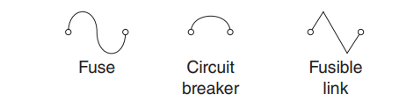
Circuit Protective Devices
When overloads or shorts in a circuit cause too much current to flow, the wiring in the circuit heats up, the insulation melts, and a fire can result, unless the circuit has some kind of protective device.
Fuses, fuse links, maxi-fuses, and circuit breakers are designed to provide protection from high current.
They may be used singly or in combination.

Slide 35
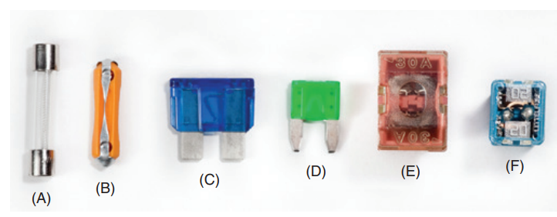
Fuses
Automotive fuses are normally rated for circuits no higher than 24 volts DC, but some may be rated for 42-volt systems.
There are three basic types of fuses used in automobiles: cartridge, ceramic, and blade.
A cartridge fuse, or glass tube fuse, was commonly used in older domestic vehicles and a few imports.
Each fuse has a current rating marked on the top of the fuse. Also, a three-letter code is used to indicate the types and sizes of fuses.

Slide 36
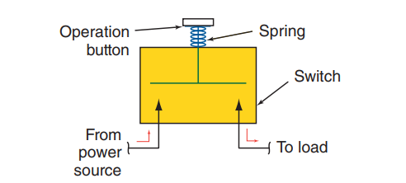
Switches (1 of 2)
Electrical circuits are usually controlled by some type of switch.
Switches do two things:
  turn the circuit on or off
  direct the flow of current in a circuit.
Switches can be controlled by the driver or can be self-operating through the condition of the circuit, the vehicle, or the environment.
A switch is defined by the job they do or the sequence in which they work. A hinged-pawl switch is the simplest type of switch. It either makes (allows for) or breaks (opens) current flow in a single conductor or circuit. This type of switch is a single-pole, single-throw (SPST) switch.
The throw refers to the point where current flows from the switch and to the number of output circuits, and the pole refers to the point where current flows into the switch and the number of input circuits made by the switch.

Slide 37
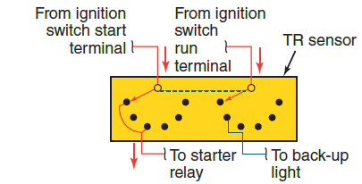
Switches (2 of 2)
Switches can have a great number of poles and throws.
The transmission neutral start switch shown has two poles and six throws and is referred to as a multiple-pole, multiple-throw (MPMT) switch.
It has two movable wipers that move in unison across two sets of terminals. The dotted line shows that the wipers are mechanically linked, or ganged.
It is important to realize that current flows only through the circuits that are mechanically connected by the switch.
Most switches are combinations of hinged-pawl and push-pull switches, with different numbers of poles and throws.
A mercury switch is sometimes used to detect motion in a component, such as the one used in the engine compartment to turn on the compartment light.

Slide 38
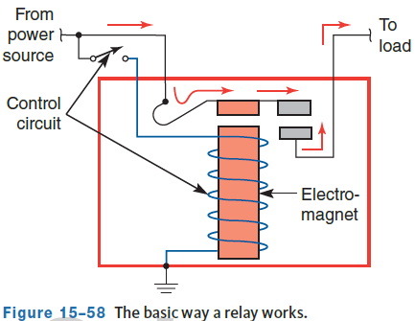
Relays
A relay is an electric switch that allows a small amount of current to control a high-current circuit.
When the control circuit switch is open, no current flows to the coil of the relay, so the windings are de-energized.
When the switch is closed, the coil is energized, turning the iron core into an electromagnet and drawing the armature down.
This closes the power circuit contacts, connecting power to the load circuit.

Slide 39
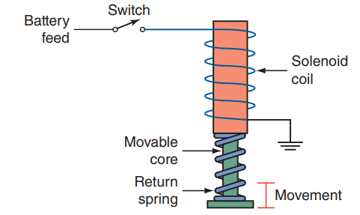
Solenoids
Solenoids are also electromagnets with movable cores used to change electrical current flow into mechanical movement.
They are used in a wide variety of systems and can also close contacts, acting as a relay at the same time they mechanically cause something to happen.

Slide 40
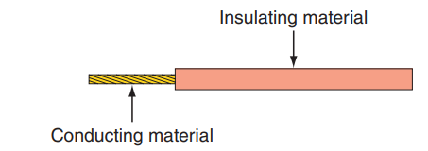
Conductors and Insulators
Controlling and routing the flow of electricity requires the use of materials known as conductors and insulators.
Conductors are materials that have low resistance to current flow. If the number of electrons in the outer shell or ring of an atom is less than 4, the force holding them in place is weak. The voltage needed to move these electrons and create current flow is relatively small. These materials, such as copper, silver, and aluminum, are good conductors.
When the number of electrons in the outer ring is greater than 4, the force holding them in orbit is very strong, and very high voltages are needed to move them. These materials are known as insulators. They resist the flow of current.

Slide 41
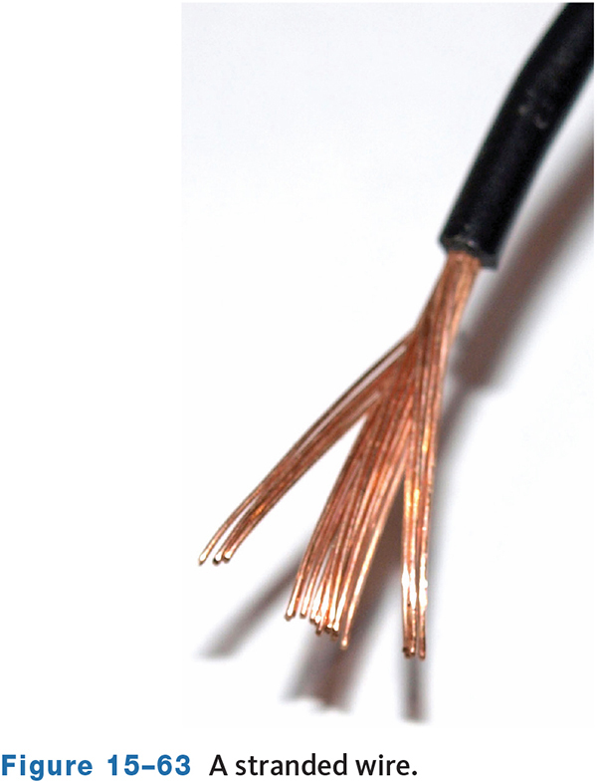
Wires (1 of 2)
Two basic types of wires are used: solid and stranded.
Solid wires are single-strand conductors.
Stranded wires are the most common and are made up of a number of small solid wires twisted together to form a single conductor.
Wire size standards were established by the Society of Automotive Engineers (SAE).
These standards are called the American wire gauge (AWG) system.
Sizes are identified by a numbering system ranging from gauge size 0 to 40, with number 0 being the largest and number 40 the smallest in a cross-sectional area.
Most automotive wiring range from number 10 to 24, with battery cables normally 4 gauge or lower.
Battery cables must be large gauge wires because of the heavy current they must carry.
Some manufacturers list wire size in metric sizes.

Slide 42
Knowledge Check (2 of 2)
Which wire is larger, a 4 gauge wire, or a 24 gauge wire?

Slide 43
Knowledge Check Answer (2 of 2)
4 Gauge wire is much larger than 24.

Slide 44
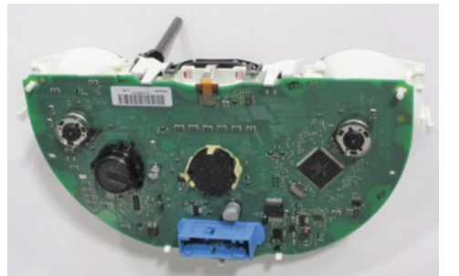
Wires (2 of 2)
Many vehicles use flexible printed circuits and printed circuit boards.
Both types of printed circuits allow for complete circuits without the need to run dozens of wires.
Printed circuit boards are typically contained in a housing, such as the engine control module.
These boards are not serviceable and in some cases not visible. When these boards fail, the entire unit is replaced. A flexible printed circuit saves weight and space.
It is made of thin sheets of nonconductive plastic onto which conductive metal, such as copper, has been deposited.
Parts of the metal are then etched or eaten away by acid. The remaining metal lines form the conductors for the various circuits on the board.

Slide 45
Chapter Reflection
Please take a moment to compare your perception of the automotive industry before and after you studied this chapter. Then respond to the following questions in one or two paragraphs. Use 150–200 words in your reflection.
Did anything in this chapter change your thinking about automotive careers? Describe any of the basic theories and math that interest you most.
Considering all you have learned, do you feel you are able to apply basic theories and math to automotive specific systems?

